Slide 1

Charting the Course for Our Future
Session: Introduction to AI/ML in Drug Development
Chairs: Patrick Hanafin; Jagdeep Podichetty, Ph.D.
Part 2. Hands-on tutorial
November 2021

Slide 2
Agenda
Part 2 – Hands-on tutorial
Instructors: Mr. Patrick Lang and Dr. Jagdeep Podichetty
Coaches:
Introduction to Hand-on tutorial (15 min)
Break-out work session Part 1 (40 min)
Break (5 min)
Break-out work session Part 2 (30 min)
Submit results (5 min)
Presentation and debrief (30 min)
Jackson Burton, Ph.D.
Ayyappa Chaturvedula, Ph.D.
Juan Fransisco Morales, Ph.D.
Navin Goyal, Ph.D.
Vijay Ivaturi, Ph.D.
Sarak Kim, Ph.D.
Karthik Lingineni, Ph.D.
Gengbo Liu, Ph.D.
Dana Lu, Ph.D.
Mohamed Shahin, Ph.D.
Notes:
Patrick Lang
Patrick Lang is a data practitioner with over 2 years of experience in data management, visualization, and analytics, information systems, and clinical data research. He is responsible for data efforts in the Type 1 Diabetes Consortium (T1DC) and the Transplant Therapeutics Consortium (TTC) at C-Path, while also contributing to the organization’s AI/ML efforts. In his time at C-Path, he has supported efforts to develop disease progression models, survival models, and novel machine learning approaches to support unmet needs in multiple disease areas. He has been involved in the creation of multiple abstracts and posters for conferences. Recently, his work with the T1D prevention effort won the American Conference on Pharmacometrics (ACoP) quality award.

Slide 3
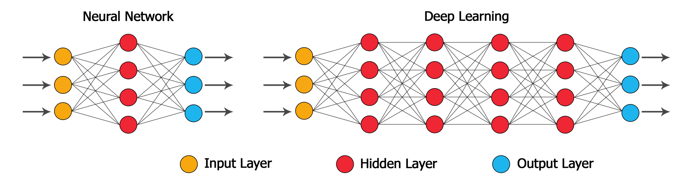




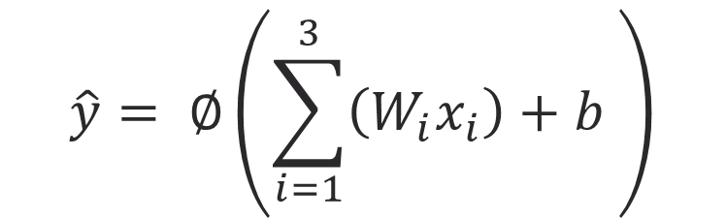




Neural Net Building Blocks
$$x1$$
Artificial Neuron
Activation function
Bias
$$w1$$
∑
$$\hat{y}= ∅\left(\sum_{i=1}^{3}{\left(W_{i}x_{i}\right)+b }\right)$$
$$x2$$
$$w2$$
$$∅$$
$$\hat{y}$$
$$w3$$
$$x3$$
Bias
1. https://www.datacamp.com/community/tutorials/deep-learning-python
2. https://medium.com/things-i-could-never-make-up/neural-network-building-blocks-7ea6f8c790bf

Slide 4








Building Blocks – Artificial Neuron
Inputs: Data fed to the input layer (x_{N})
Weights: Each input has a weight associated to it that determines the importance of the input (w_{N})
Bias: An offset for the sum of weights into a neuron, to ensure the sum is above/below a threshold
Activation Function: Determines if the neuron will “fire” (ф)
$$x1$$
Artificial Neuron
$$w1$$
∑
$$x2$$
$$w2$$
$$∅$$
$$\hat{y}$$
$$w3$$
$$x3$$
Bias
1. https://www.datacamp.com/community/tutorials/deep-learning-python
2. https://medium.com/things-i-could-never-make-up/neural-network-building-blocks-7ea6f8c790bf
4

Slide 5
DL workflow
Dataset
1
Data Preprocessing
Analysis Subset
Training Set (80%)
Validation Set (20%)
2
3
Balancing Training Set*
Splitting Data
(Randomized)
Balanced Training Set
4
Model Training
5
Neural Net Model
Model
Validation
Outcome
Prediction Performance
* Not required for Regression
5
Notes:
Typical workflow for a classification problem in ML
Validation need not be balanced

Slide 6
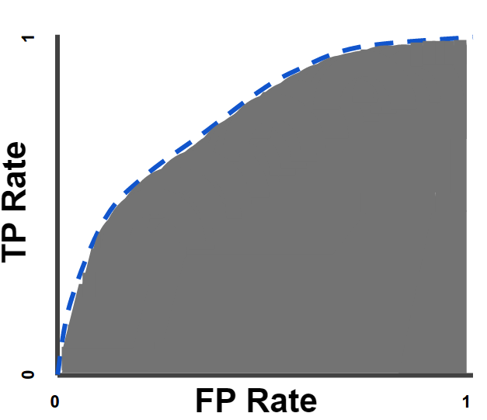
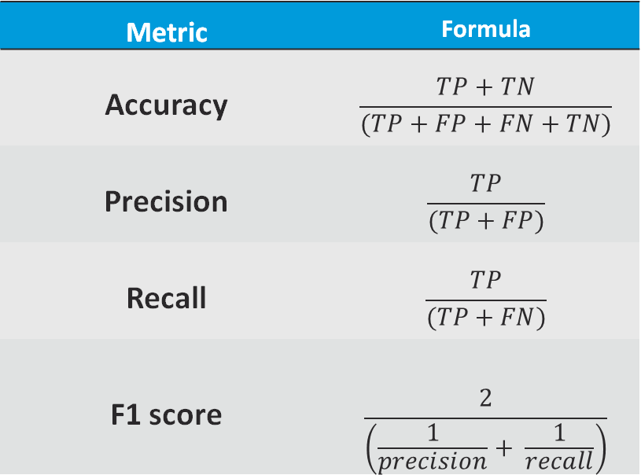
Model Performance - Classification
 | Predicted: Yes | Predicted: No
Actual: Yes | True Positive (TP) | False Negative (FN)
Actual: No | False Positive (FP) | True Negative (TN)
Confusion Matrix:
Metric | Formula
Accuracy | $$\frac{TP+TN}{(TP+FP+FN+TN)}$$
Precision | $$\frac{TP}{(TP+FP)}$$
Recall | $$\frac{TP}{(TP+FN)}$$
F1 score | $$\frac{2}{\left(\frac{1}{precision}+ \frac{1}{recall}\right)}$$
Receiver Operating Characteristic (ROC) curve
https://heartbeat.fritz.ai/introduction-to-machine-learning-model-evaluation-fa859e1b2d7f
https://developers.google.com/machine-learning/crash-course/classification/roc-and-auc
6
Notes:
precision is also referred to as positive predictive value (PPV)
Recall is call sensitivity or TPR
FPR is also 1- Sensitivity
F1 score is Harmonic mean of precision and recall. To allow recall and precision to be evenly weighted.
https://en.wikipedia.org/wiki/Precision_and_recall

Slide 7
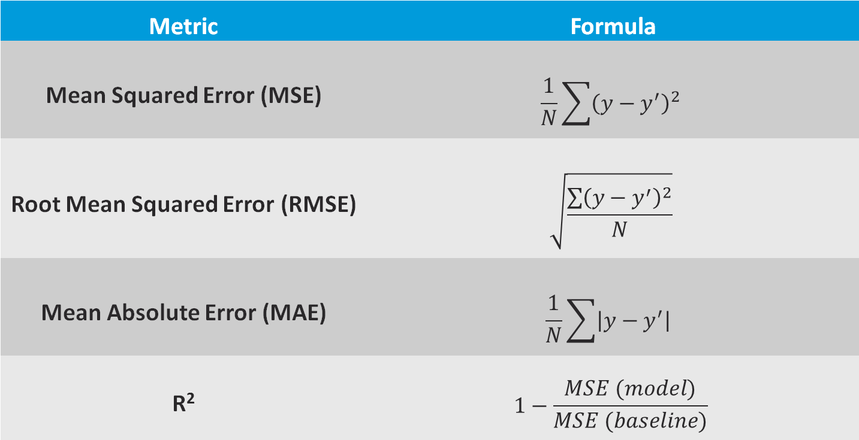
Model Performance – Regression
Metric | Formula
Mean Squared Error (MSE) | $$\frac{1}{N}\sum{{\left(y−y^{′}\right)}^{2}}$$
Root Mean Squared Error (RMSE) | $$\sqrt{\frac{\sum{{\left(y−y^{′}\right)}^{2}}}{N}}$$
Mean Absolute Error (MAE) | $$\frac{1}{N}\sum{\left|y−y^{′}\right| }$$
R² | $$1−\frac{MSE (model)}{MSE (baseline)}$$
N: number of samples, y: actual value, and y’: prediction value
https://heartbeat.fritz.ai/introduction-to-machine-learning-model-evaluation-fa859e1b2d7f
https://towardsdatascience.com/deep-learning-performance-cheat-sheet-21374b9c4f45
7

Slide 8
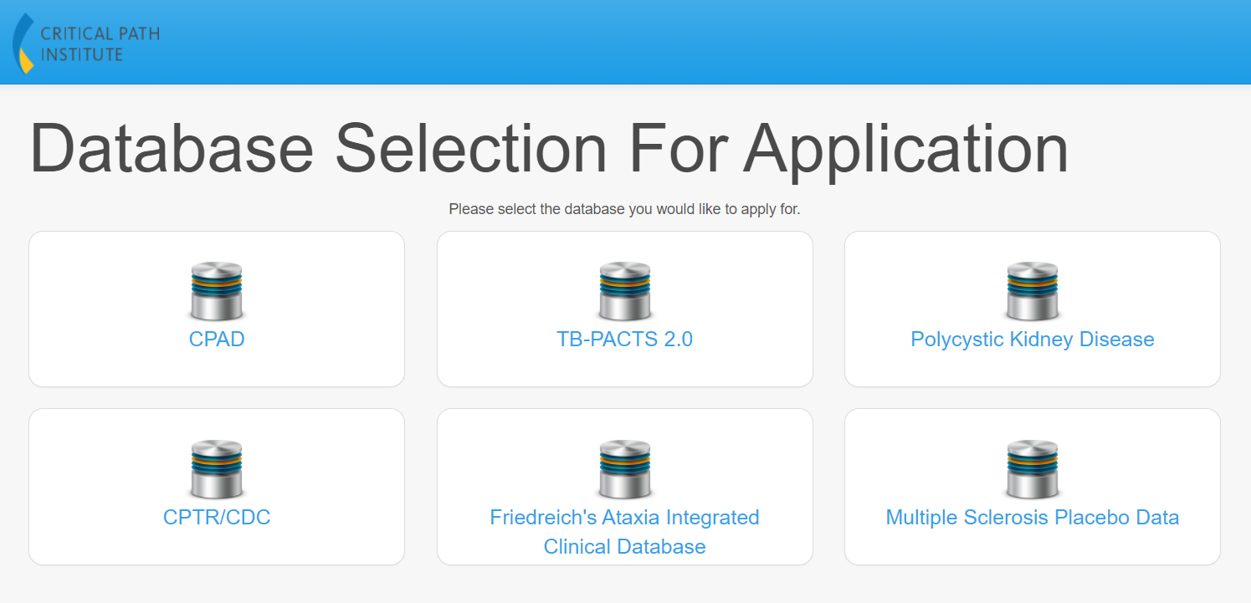
Use Case in Alzheimer's disease: AD state classification
https://codr.c-path.org/main/applyDatabaseSelection.html
Analysis Data: Simulated patient level data based on the non-linear mixed models
8
Notes:
This model is meant to be as simplified as possible to go over the workflow and the functions behind a neural network
Everything is on github for you to check out, link will be provided later

Slide 9
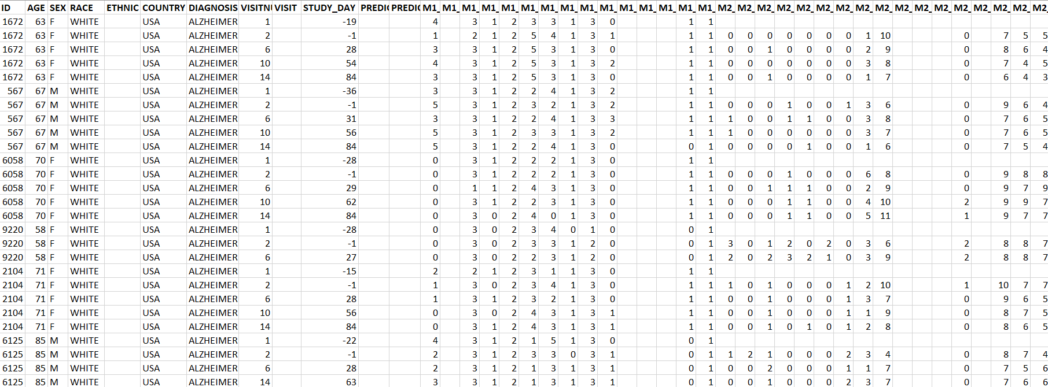
Initial Data Structure
Patient Characteristics
Timing
ADAS-Cog 11 Item Level Scores
Notes:
Longitudinal patient level data
Baseline patient information
Timing variable
Item level scores, need to derive ADAS-Cog 11 score

Slide 10
DL workflow – Model Training
Parameter Initialization
Forward Propagation
Cost Function
Iterate
Backward Propagation
Parameter Updating
10
Notes:
The cost function is calculated as an average of loss functions. The loss function is a value which is calculated at every instance.
Before we get into building out functions to perform these steps, we first need to perform some data preprocessing

Slide 11
Let's Begin…

